Slide 1

TOTAL STATION
By
Adithya Krishnan
S1 CSE 1
Roll No: 8

Slide 2
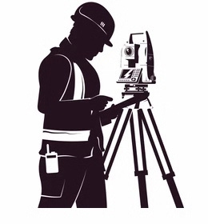
INTRODUCTION
A total station is a combination of an electronic theodolite, an electronic distance measuring device (EDM) and a micro processor with memory unit. This combination makes possible to determine the coordinates of a reflector aligning the instruments cross hairs on the reflector and simultaneously measuring the vertical and horizontal angles and slope distances. A micro processor in the intrument takes care of recording ,and the necessary computation

Slide 3

FUNCTIONS
1.Angle measurement
2.Distance measurement
3.Coordinate measurement
4.Data processing

Slide 4

PRINCIPLE
•Total station can measure horizontal and vertical angles as well as slope distances.
•Distance can be determined by calculating the number of wavelengths travelled.
•Using the vertical angle, the total station can calculate the horizontal and vertical distance components of the measured slope distance. Total station measures three parameters when aimed at the object:-
1) Horizontal angle
2) Vertical angle
3) Slope distance

Slide 5
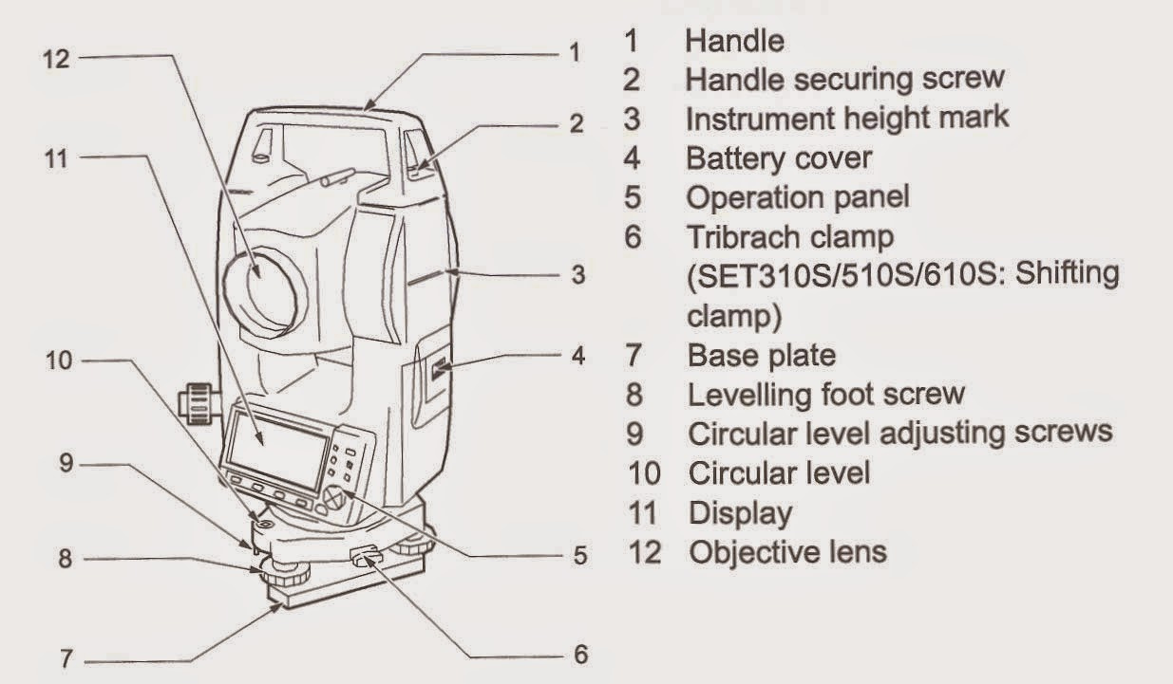
LABELLED DIAGRAM

Slide 6
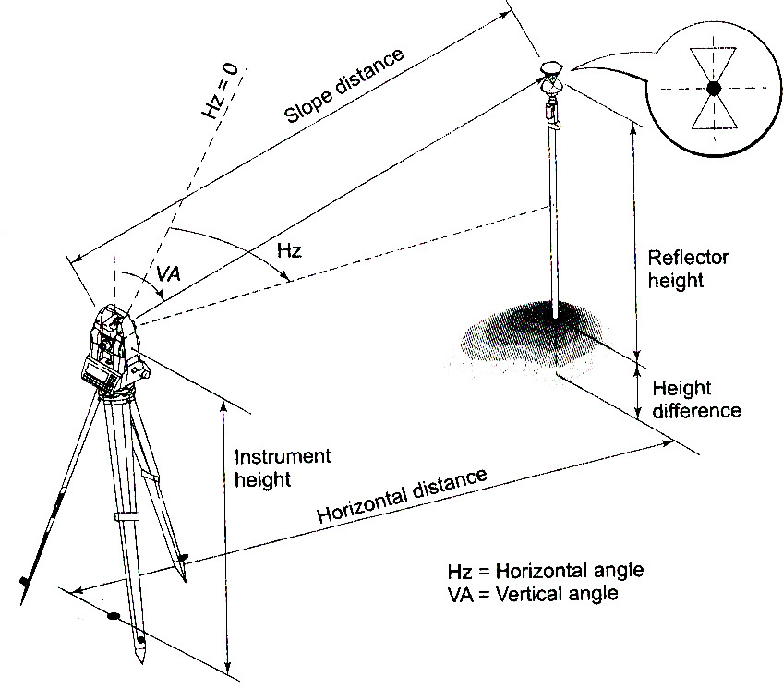
WORKING
•Consider two points A and B , and we have to calculate the distance between them. First a transmitter is placed at point A. Then a receiver is placed at another point B. Now an electromagnetic wave is propagated from A to B, reaches the reflector and return back to the EDM.
•Then the distance is measured with the help of time taken by the wave for the emission and return. But measuring the transit time is little tougher. Therefore a reflector is placed at B . The point A act as transmitter and receiver. Thus the double transit time is calculated.
•The distance is measured by the phase difference between the transmitted and received signals.

Slide 7

APPLICATIONS
•Total stations are mainly used by land surveyors and civil engineers, either to record features as in topographic surveying or to set out features civil engineering projects like dams, bridges, tunnels etc.
•Contouring, mapping and area measurement through suitable software and connection to computer
•Mining applications : Record absolute location of tunnel walls, ceilings
•Fixing 3D coordinate of stations with respect to a reference station
•Measurement of horizontal and vertical angle and sloping distances

Slide 8
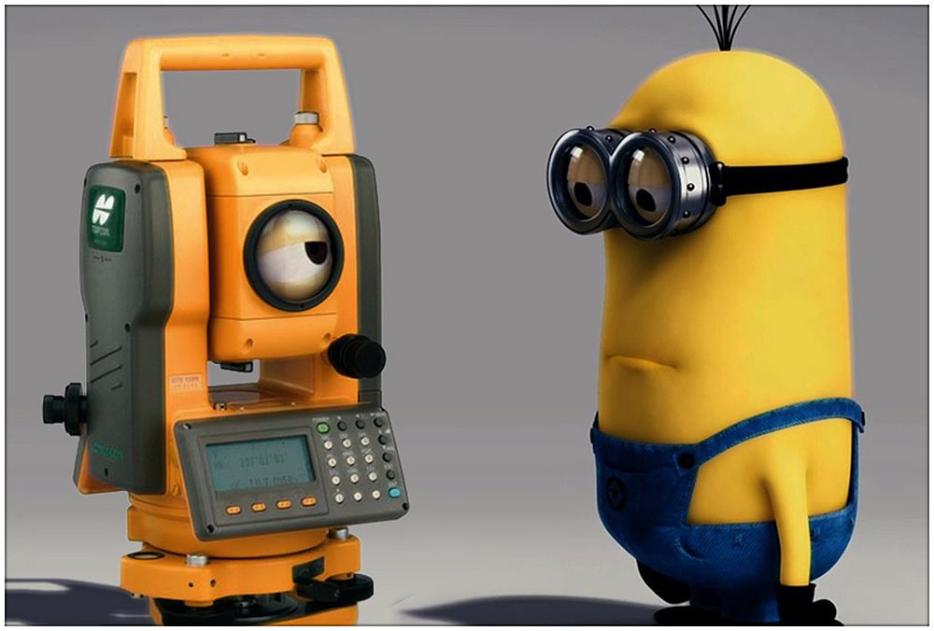
ADVANTAGES AND DISADVANTAGES

Slide 9

ADVANTAGES
•Field work is carried out very fast.
•Accuracy of measurement is high.
•Manual errors involved in reading and recording are eliminated.
•Calculation of coordinates is very fast and accurate.
•Even corrections for temperature and pressure are automatically made.
•Computers can be employed for map-making and plotting contour and cross-sections.
•Contour intervals and scales can be changed in no time.
•User friendly interface

Slide 10
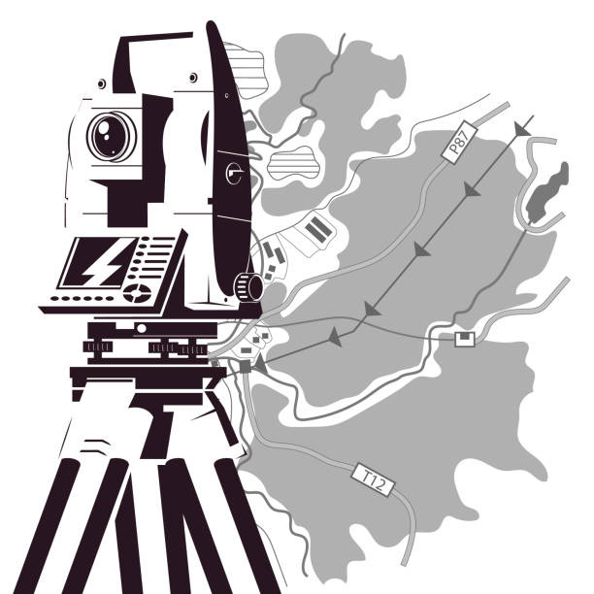
DISADVANTAGES
•Vertical elevation accuracy is not so accurate as using conventional survey level and rod technique
•Visibility is very important
•More expensive
•Awareness on battery maintenance

Slide 11
Thank You

